Slide 1

AWS for Java Developers
#CampusParty2023

Slide 2

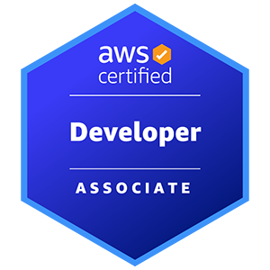
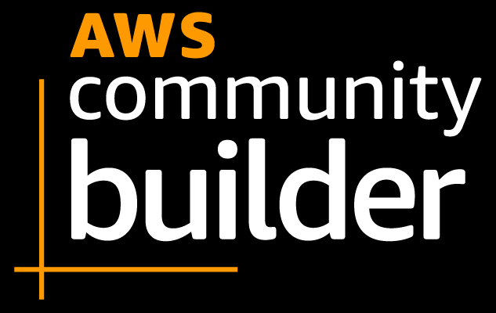




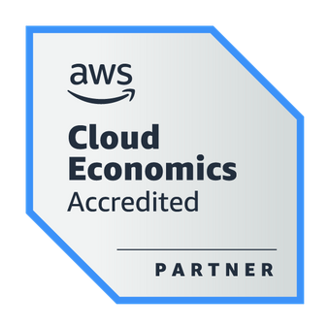
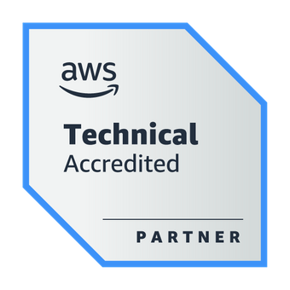
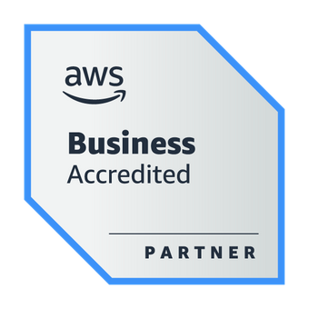

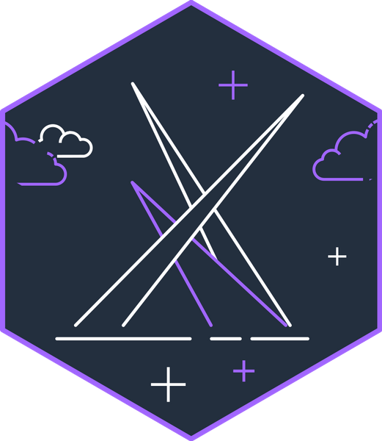
About the Speaker
Weder Mariano de Sousa
Specialist Senior - GFT
Technician System Development
Graduated Computer Science
https://www.linkedin.com/in/wedermarianodesousa/
Post Graduate in Midias UFG
https://github.com/weder96
Post Graduate in Information Security
https://twitter.com/weder96
https://dev.to/weder96
GOJava
AWS User Group Goiânia

Slide 3
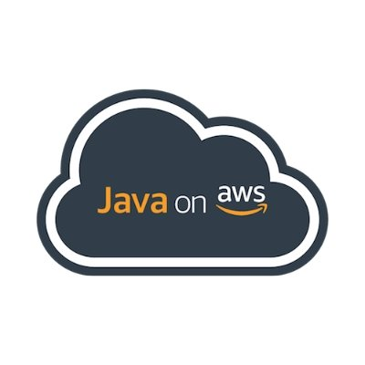
Agenda
SDK for Java
AWS IDE Toolkits
AWS CDK for Java
Amazon Corretto
EC2 with Springboot
Beanstalk and Springboot
Docker and Fargate with Springboot
Pipelines with Java Springboot
Serverless - Java and Lambdas with Springboot
AWS Lambda SnapStart for Spring Developers

Slide 4
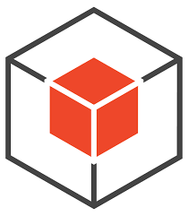
SDK for Java
01

Slide 5
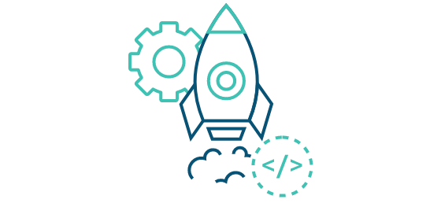
What is SDK for Java ?
The AWS SDK for Java simpliﬁes use of AWS Services by providing a set of libraries that are consistent and familiar for Java developers.
It provides support for API lifecycle consideration such as credential management, retries, data marshaling, and serialization. The AWS SDK for Java also supports higher level abstractions for simplified development.
GitHub to see examples (https://github.com/awsdocs/aws-doc-sdk-examples/tree/main) AWS-focused open source Java libraries.
- Aws Page Main Language Java
https://aws.amazon.com/developer/language/java/?nc1=h_ls

Slide 6
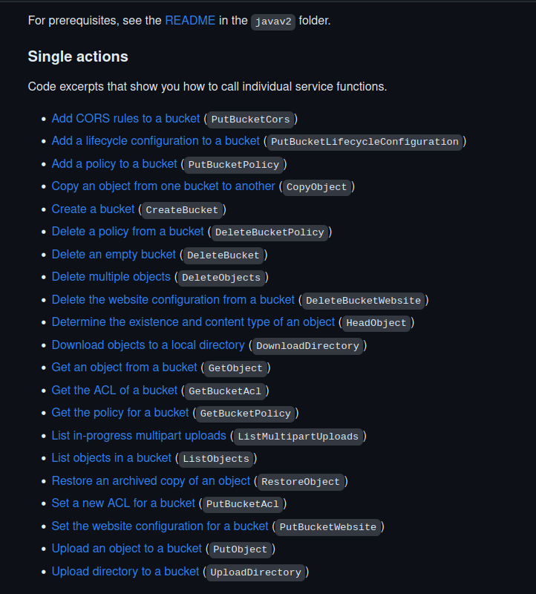
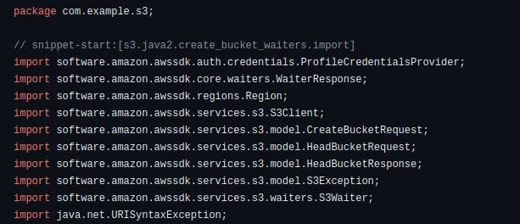
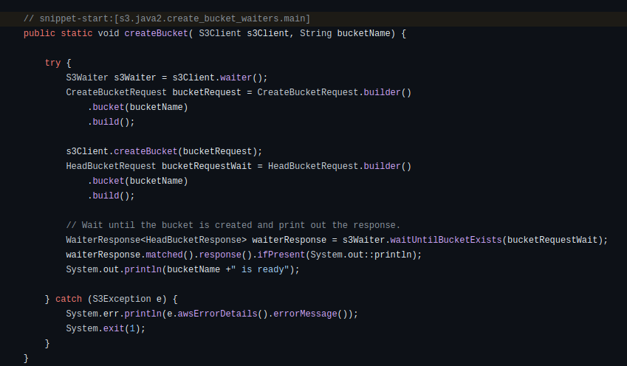
Demo SDK for Java
https://aws.amazon.com/sdk-for-java/
https://github.com/awsdocs/aws-doc-sdk-examples/tree/main/javav2/example_code/s3

Slide 7

02
AWS IDE Toolkits

Slide 8
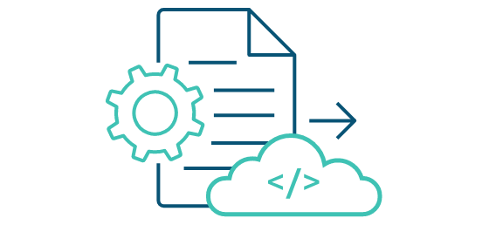
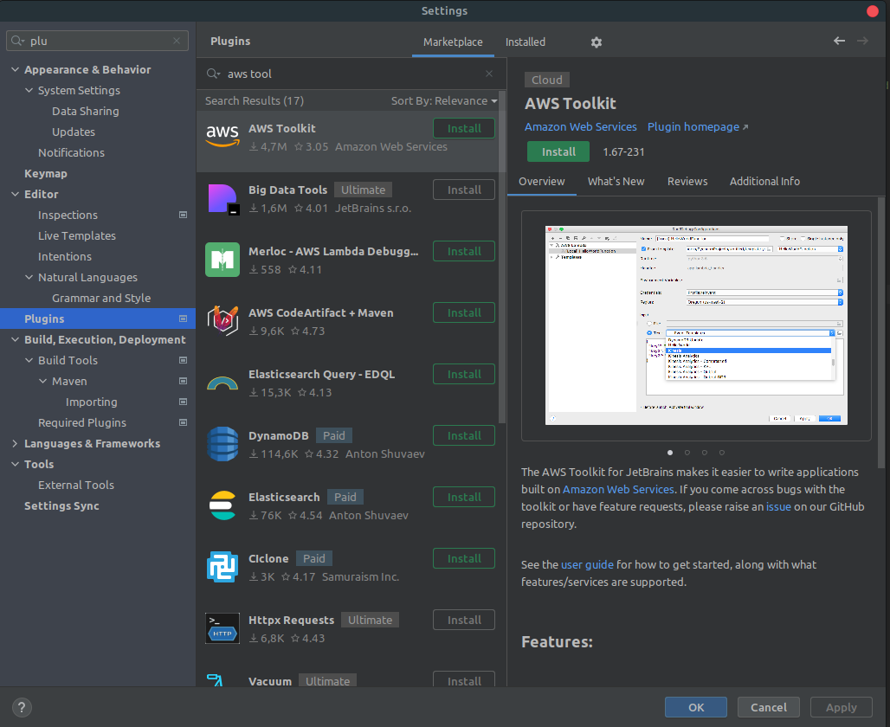
What is Toolkits de IDE da AWS ?
https://aws.amazon.com/intellij/

Slide 9
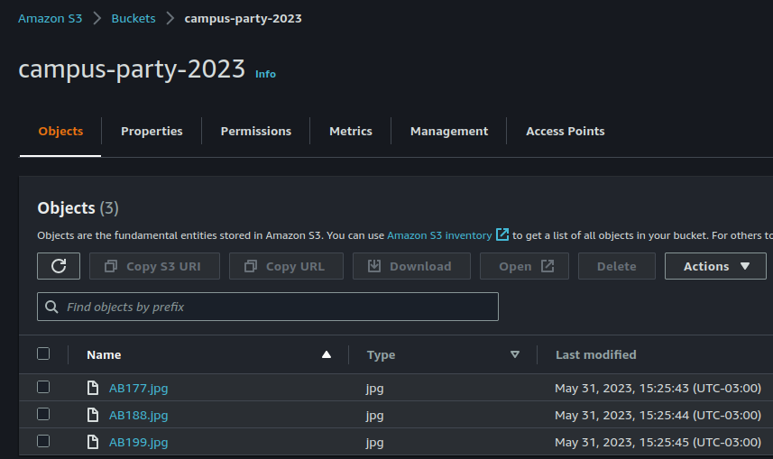
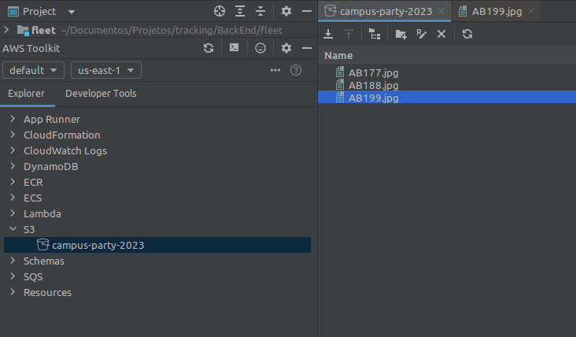
What is Toolkits de IDE da AWS ?
https://aws.amazon.com/intellij/

Slide 10
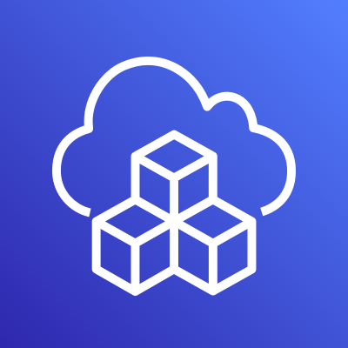
AWS CDK for Java
03

Slide 11
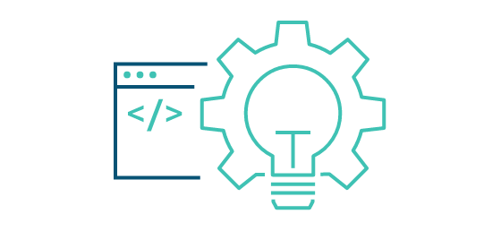
What is AWS CDK?
The AWS Cloud Development Kit (AWS CDK) is an open-source software development framework for defining cloud infrastructure as code with modern programming languages and deploying it through AWS CloudFormation.
https://aws.amazon.com/cdk/faqs/
https://aws.amazon.com/cdk/?nc1=h_ls

Slide 12
Difference between v2 and v1
CDK v1
CDK v2
"dependencies": {
"@aws-cdk/aws-amplify": "^1.125.0",
"@aws-cdk/aws-appsync": "^1.125.0",
"@aws-cdk/aws-codepipeline": "^1.125.0",
"@aws-cdk/aws-cognito": "^1.125.0",
"@aws-cdk/aws-lambda": "^1.125.0",
"@aws-cdk/aws-sns": "^1.125.0",
"@aws-cdk/core": "1.125.0",
"@aws-cdk/pipelines": "^1.125.0",
}
"dependencies": {
"aws-cdk-lib": "2.0.0",
"constructs": "^10.0.0",
"@aws-cdk/aws-iot-alpha": "^2.0.0-alpha.0"
}
import { App, Stack } from "@aws-cdk/core";
const lambda = require("@aws-cdk/aws-lambda");
import { App, Stack } from "aws-cdk-lib";
const s3 = require("aws-cdk-lib/aws-s3");
Notes:
In this example you can see how the packaging between v1 and 2 differs.
This example is using typescript and you can see that in the package json the amount of dependencies we need to import is very long.
When ever we update the version of CDK we need to update all the versions of all the dependencies. This is quite tedious work.
In the case of v2 there is only one package for all the libraries and then if we want to use some experimental construct we can just import that library with the specific version we are interested in.

Slide 13
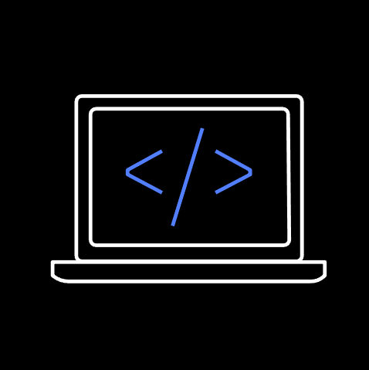
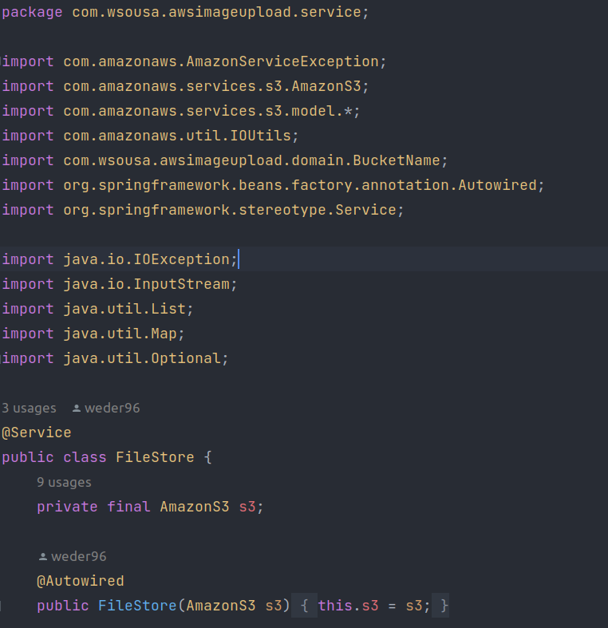





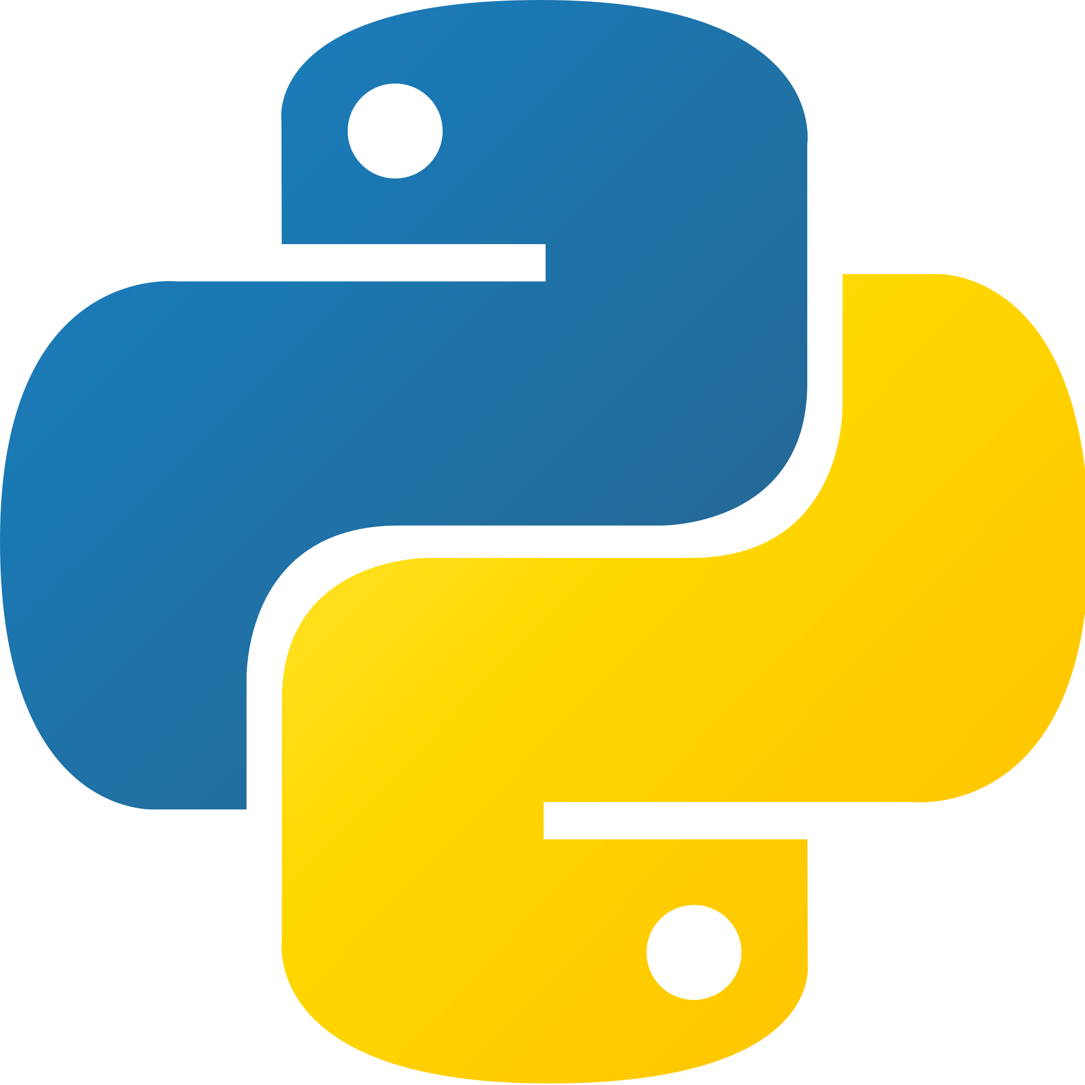
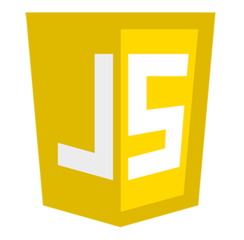

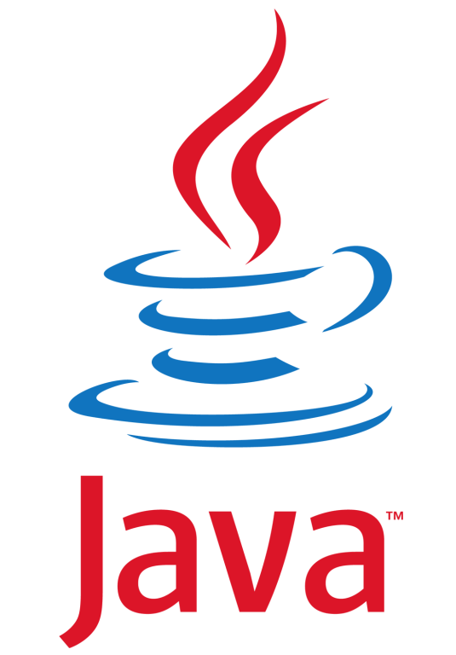
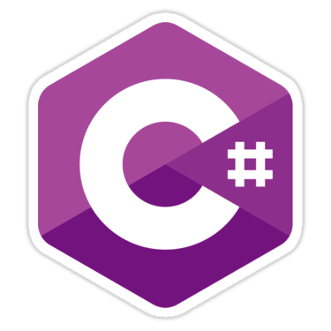


AWS Cloud Development Kit (CDK)
A multi-language software development framework for modeling cloud infrastructure
as reusable components
COMING
SOON!

Slide 14
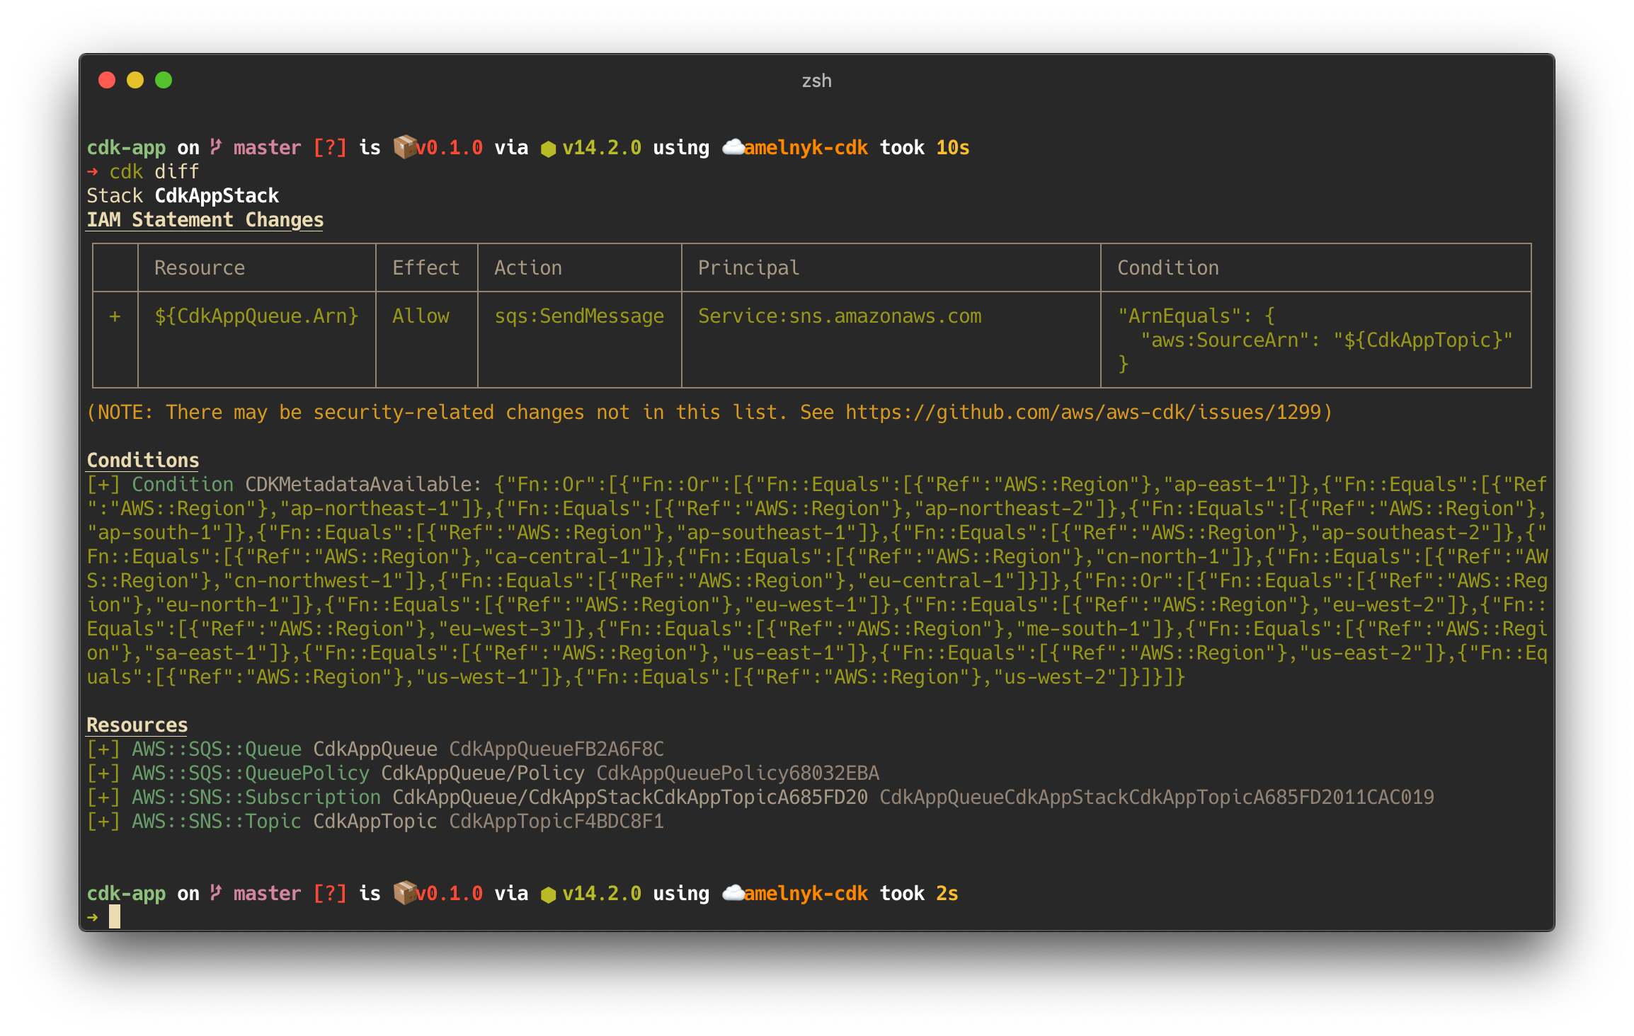


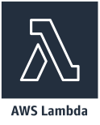
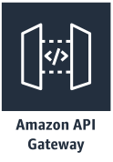
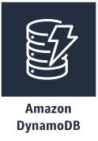
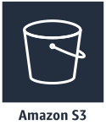


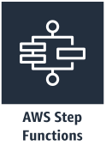

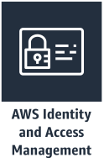



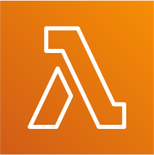


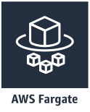

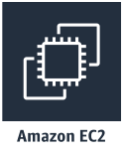
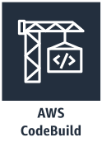
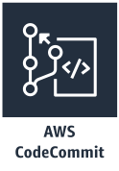
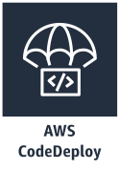
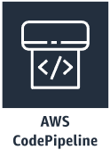
Main Components
Serverless
App Integration / Foundational Services
App
Stacks
Containers
CI/CD
Resources
Core Framework
AWS Construct Library
AWS CDK CLI

Slide 15

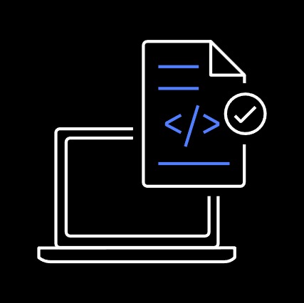


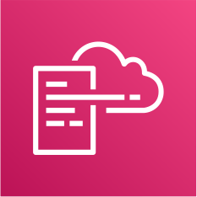
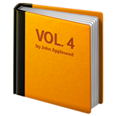




Development Workflow
execute
synthesize
deploy
provision
Stacks & Constructs
Source Code
CDK CLI
Templates + Assets
Cloud Assembly
AWS CloudFormation
Cloud Resources
cdk init
// create new project
npm run build
// build project
cdk synth
// create templates and assets
cdk diff
// check what will change
cdk deploy
// push changes to your account
https://www.youtube.com/watch?v=R7wSTZ54gNk&t=261s
© 2020, Amazon Web Services, Inc. or its Affiliates. All rights reserved. Amazon Confidential and Trademark.

Slide 16
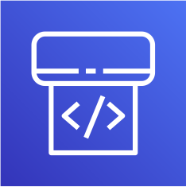
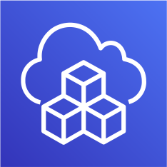



Best Practice – Deploy to multiple accounts
Fubuki’s Account
Saitama’s Account
Shared Services Account
Pipeline
cdk deploy
Source
Control
git push
Dev
Account
Homol
Account
Prod
Account
Fubuki
Saitama

Slide 17
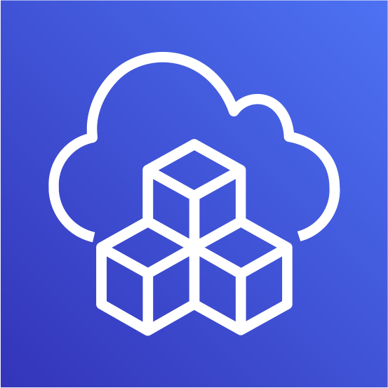

Application Development

Slide 18
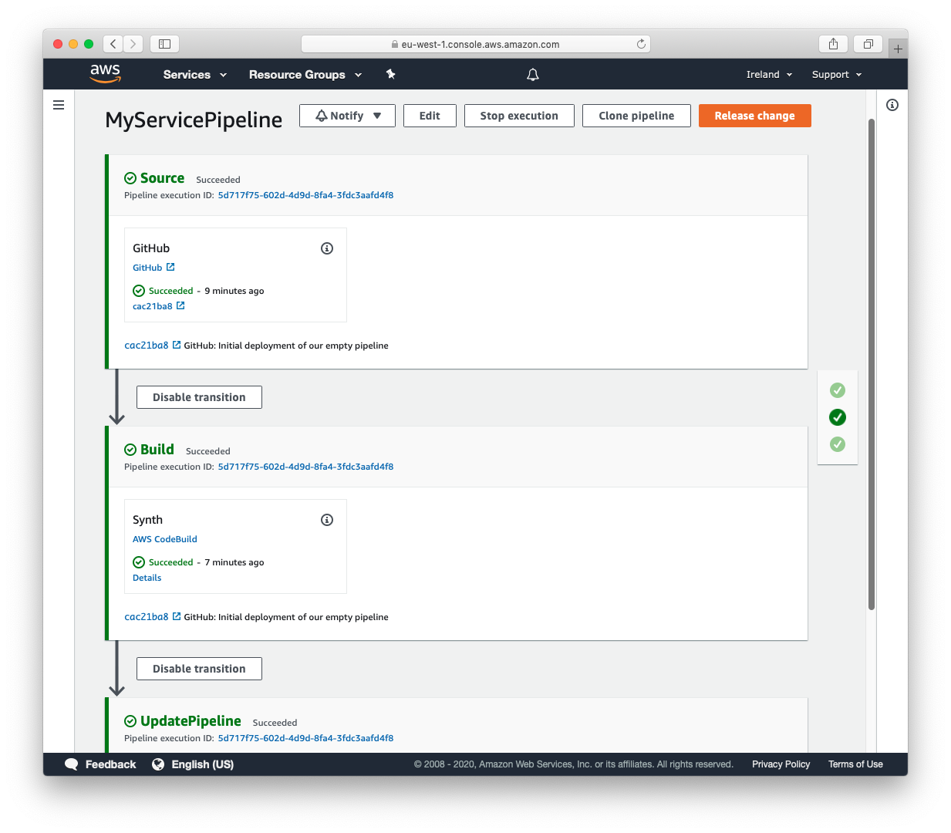
CDK Pipelines
Continuous delivery for AWS CDK applications
Model continuous delivery pipelines as
part of your infrastructure code.
Easily model cross-account and cross-region
pipeline configurations.
Pipelines are self modifying as
you push your CDK code to origin.

Slide 19
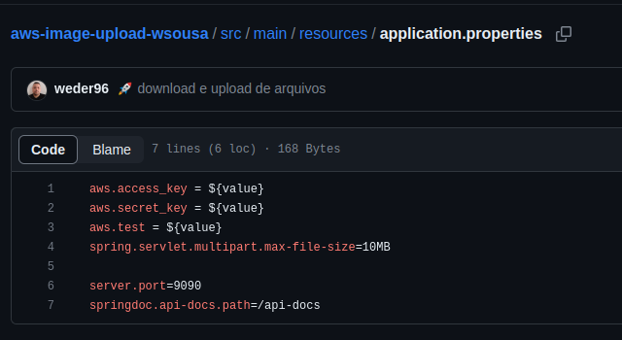
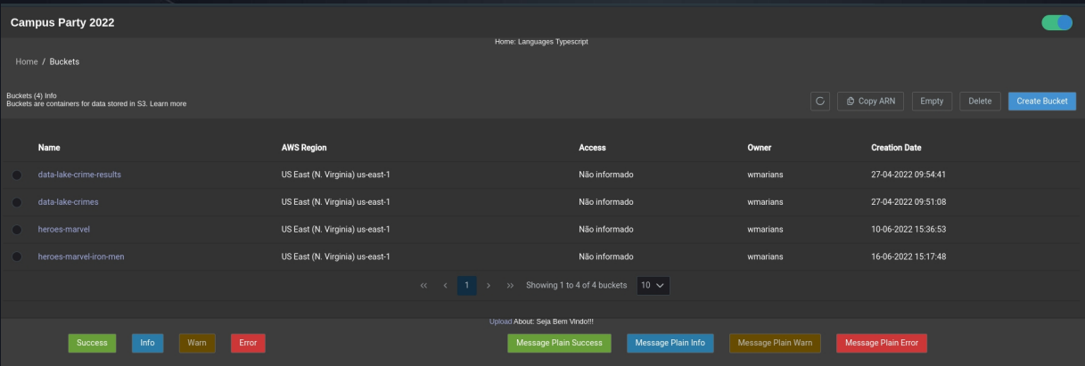
Demo CDK
Clone S3 AWS with CDK
https://github.com/weder96/aws-image-upload-wsousa
https://github.com/weder96/presentationCampusParty2022

Slide 20
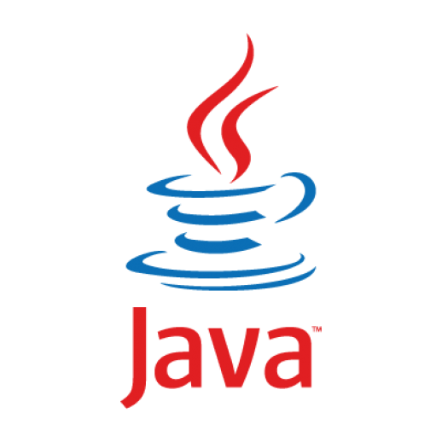

Amazon Corretto
04

Slide 21
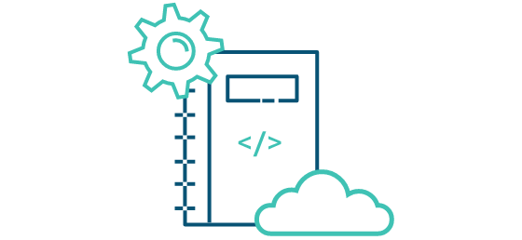
What is Amazon Corretto ?
Amazon Corretto is a no-cost, multiplatform, production-ready distribution of the Open Java Development Kit (OpenJDK).
Corretto comes with Long-Term Support(LTS) that will include performance enhancements and security fixes. Amazon runs Corretto internally on thousands of production services and Corretto is certified as compatible with the Java SE standard. With Corretto, you can develop and run Java applications on popular operating systems, including Linux, Windows, and macOS.
https://aws.amazon.com/corretto/?filtered-posts.sort-by=item.additionalFields.createdDate&filtered-posts.sort-order=desc

Slide 22
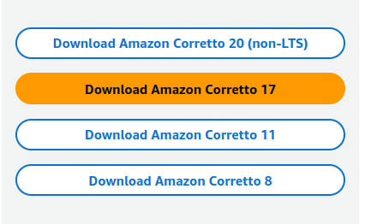
Long-Term Support(LTS) ?
Benefits
1. Backed by Amazon
2. Production Ready
3. Multiplatform Support
4. No Cost
https://aws.amazon.com/corretto/?filtered-posts.sort-by=item.additionalFields.createdDate&filtered-posts.sort-order=desc

Slide 23


EC2 with Spring boot
05

Slide 24






Architecture (EC2)
BackEnd
AWS Cloud
Availability Zone
EC2 instance
SSH
Permissions
T2 instance

Slide 25




Ec2 Baisc Server Instance
https://github.com/weder96/campusParty3/tree/main/backEnd/campus

Slide 26




Ec2 Baisc Server Instance - Deploy Application Java and Mysql
https://github.com/weder96/campusParty3/tree/main/backEnd/campus

Slide 27

Beanstalk and Spring boot
06

Slide 28
Architecture (Beanstalk)
BackEnd
AWS Cloud
Availability Zone
EC2 instance
choose Jar
AWS Elastic Beanstalk
T2 instance

Slide 29


Docker and Fargate with Spring boot
07

Slide 30

Architecture (Docker Hub)
BackEnd
Hub
AWS Cloud
Availability Zone
EC2 instance
push
pull
install
T2 instance

Slide 31


Create Account Docker Hub(Repository) and Login

Slide 32



Push Project Spring boot to Docker Hub
https://github.com/weder96/campusParty3/tree/main/backEnd/campus_docker

Slide 33


Pull Project Docker Hub
https://docs.docker.com/engine/reference/commandline/pull/

Slide 34


Test Project Spring boot (localhost)

Slide 35




Test Project Spring boot (EC2 Instance)
https://www.digitalocean.com/community/tutorials/how-to-install-and-use-docker-on-ubuntu-20-04-pt

Slide 36


Architecture (Docker Hub and Fargate)
BackEnd
Hub
AWS Cloud
Availability Zone
AWS Fargate
push
pull
Amazon Elastic Container Service (Amazon ECS)
Amazon CloudWatch

Slide 37


ECS and Fargate
# Create Cluster
# Create Task Definitions

Slide 38



Create Task Definitions

Slide 39

Linked Task and Cluster

Slide 40

Log Events - Cloud Watch

Slide 41

Call API by Public IP:Port

Slide 42

Pipelines com Java Spring boot
08

Slide 43



Architecture (CodePipeline)
BackEnd
AWS Cloud
AWS CodePipeline
T2 instance
push
Connect
AWS CodeBuild
AWS CodeDeploy

Slide 44


Architecture (CodePipeline)
AWS Cloud
AWS CodePipeline
Virtual private cloud (DEV)
Pass
Store Artefacts
Fetch Artefacts
Connect
AWS CodeBuild
Amazon Simple Storage Service (Amazon S3)
T2 instance with
CodeDeploy Agent
Pass
Deploy Artefacts
AWS CodeDeploy

Slide 45



Springboot Pipeline Demo
https://github.com/weder96/campus_pipeline

Slide 46

Springboot Pipeline Demo
https://aws.amazon.com/pt/blogs/devops/complete-ci-cd-with-aws-codecommit-aws-codebuild-aws-codedeploy-and-aws-codepipeline/

Slide 47

Serverless Java and Lambda
09

Slide 48

Architecture (Serverless)
BackEnd
AWS Cloud
17
Command CLI or Upload
Lambda function

Slide 49



Springboot Lambda Demo
https://github.com/weder96/springboot-aws-lambda
https://docs.spring.io/spring-cloud-function/docs/current/reference/html/aws.html

Slide 50


Springboot Lambda Demo
# Create Lambda Function Java 17
https://github.com/weder96/springboot-aws-lambda

Slide 51


Springboot Lambda Demo
#Upload Jar generate command line mvn clean Install
#Runtime Settings
https://github.com/weder96/springboot-aws-lambda

Slide 52


Springboot Lambda Demo
#Environment variables
#Test
https://github.com/weder96/springboot-aws-lambda

Slide 53

Springboot Lambda Demo
#Result Test Invoke
https://github.com/weder96/springboot-aws-lambda

Slide 54
AWS Lambda SnapStart for Spring Developers
10

Slide 55

Architecture (Serverless)
BackEnd
AWS Cloud
17
Version 2
Command CLI
Lambda function
Snap Start
Lambda function

Slide 56
Reducing Cold Start
SNAPSTART
Init during deployment
Create
Execution
Environment
Download
Code
Start
Runtime
Initialize
Function
Code
Pre
Snapshot
Hook
Create
Snapshot
(optional)
Resume
Invoke
Invoke
first request
Resume
Snapshot
Post
Snapshot
Hook
Code
execution
Code
execution
(optional)
https://aws.amazon.com/pt/blogs/compute/starting-up-faster-with-aws-lambda-snapstart/

Slide 57


AWS Lambda SnapStart + Spring Cloud Function
https://github.com/weder96/snapstart

Slide 58



AWS Lambda SnapStart + Spring Cloud Function
https://github.com/weder96/snapstart

Slide 59


AWS Lambda SnapStart + Spring Cloud Function
https://github.com/weder96/snapstart

Slide 60


Want to Try?
Workshop Java on AWS Lambda
https://s12d.com/java-workshop

Slide 61
Resources
https://cdkworkshop.com
https://github.com/aws-samples/aws-cdk-examples
https://docs.aws.amazon.com/cli/latest/userguide/getting-started-install.html
https://aws.amazon.com/pt/developer/language/java/
https://docs.aws.amazon.com/toolkit-for-jetbrains/latest/userguide/setup-toolkit.html
https://aws.amazon.com/pt/intellij/
https://docs.aws.amazon.com/code-library/latest/ug/java_2_code_examples.html
https://docs.aws.amazon.com/pt_br/prescriptive-guidance/latest/patterns/deploy-a-ci-cd-pipeline-for-java-microservices-on-amazon-ecs.html
https://docs.aws.amazon.com/lambda/latest/dg/lambda-java.html
https://aws.amazon.com/pt/blogs/compute/java-17-runtime-now-available-on-aws-lambda/
https://www.slideshare.net/AmazonWebServices/java-on-aws
https://www.jrebel.com/blog/aws-java-application-setup
https://www.slideshare.net/VadymKazulkin/adopting-java-for-the-serverless-world-at-jax-2022
https://towardsaws.com/deploy-spring-boot-application-to-aws-ec2-using-docker-f359e7ad2026
https://aws.amazon.com/pt/blogs/developer/stepfunctions-fluent-api/
https://aws.amazon.com/blogs/compute/java-17-runtime-now-available-on-aws-lambda/
https://docs.aws.amazon.com/lambda/latest/dg/snapstart.html

Slide 62
About the Speaker
Q & A
Weder Mariano de Sousa
Specialist Senior - GFT
Technician System Development
Graduated Computer Science
https://www.linkedin.com/in/wedermarianodesousa/
Post Graduate in Midias UFG
https://github.com/weder96
Post Graduate in Information Security
https://twitter.com/weder96
https://dev.to/weder96
GOJava
AWS User Group Goiânia

Slide 63
THANK YOU

